Slide 1

Dashboard Kia - Hundai Theft

Slide 2
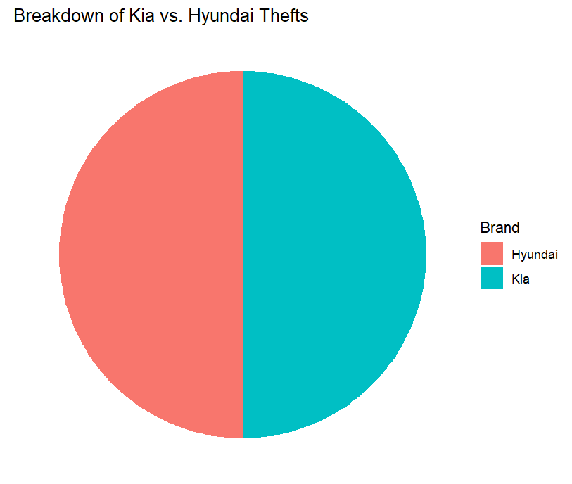
"When it comes to car thefts, not all vehicles are targeted equally. This chart breaks down the thefts between Kia and Hyundai, revealing which brand is more vulnerable. If you own one of these cars, knowing where your vehicle stands can help you take the right precautions!"

Slide 3
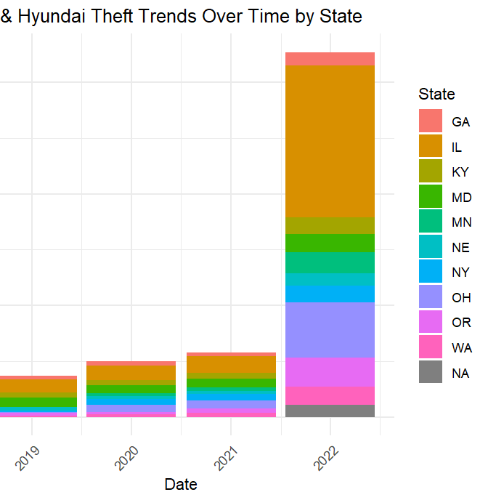
"Car theft isn’t just a national issue—it’s a local one. This chart tracks theft trends over time in different cities and states, showing where the problem is growing the fastest. If your city is on the rise, now is the time to act before it’s too late!"

Slide 4
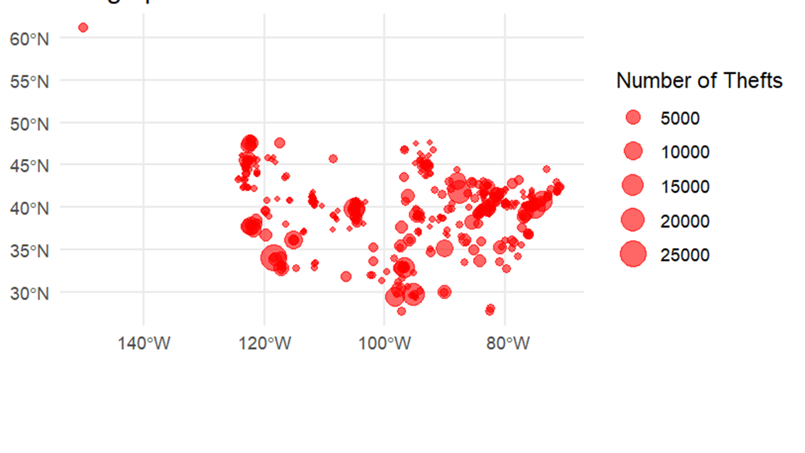
Map Visualization – Where Are Thefts Happening the Most?
"Car theft hotspots exist, and this map pinpoints where they are. Whether you're parking in these areas or just passing through, knowing the high-risk zones can help you stay alert and keep your vehicle safe!"

Slide 5
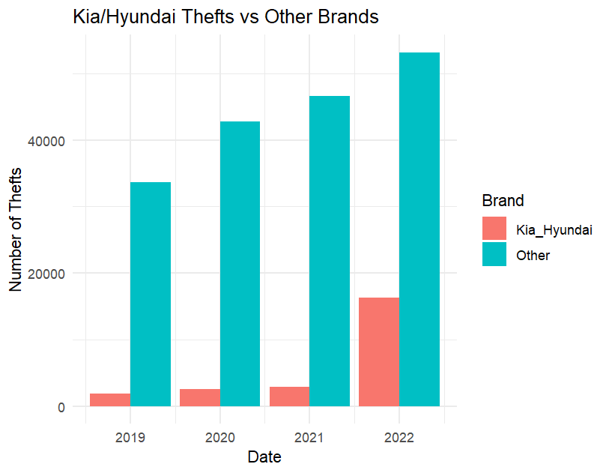
"Are Kia and Hyundai thefts really that bad, or is this just media hype? This chart puts the numbers into perspective by comparing thefts of these brands to other popular cars. The results might shock you—some cars are just much easier targets!"

Slide 6
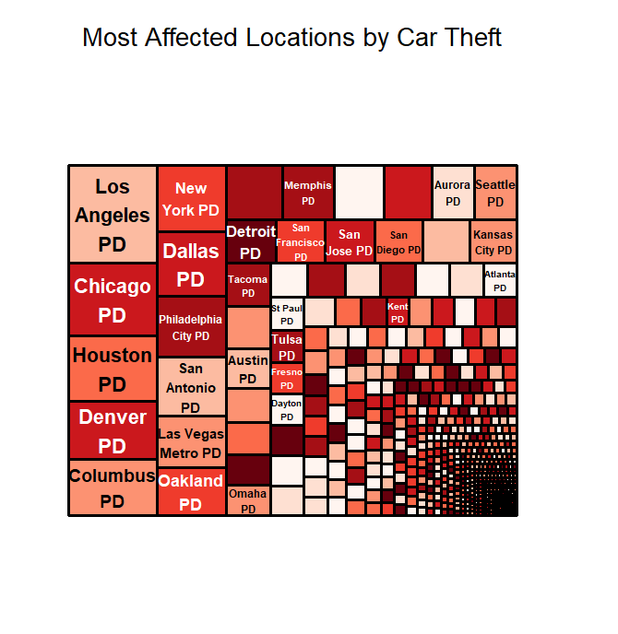
"Not all Kia and Hyundai models are stolen at the same rate, and some cities are facing a bigger crisis than others. This visualization highlights the worst-hit areas and the specific models that thieves are targeting the most. Does your car make the list? If so, it’s time to boost your security!"

